Slide 1

Funny Gorilla诙猩猩-IT培训
Your success is our success
Design Patterns

Slide 2
Page Object Model Pattern
Design Patterns
Factory pattern
Singleton pattern

Slide 3
the limitations?
Why Design Patterns?
Vanilla
@Test
void testVanillaBasicLogin() {
driver.get(“someURL");
driver.findElement(By.id("username")).sendKeys("user");
driver.findElement(By.id("password")).sendKeys("user");
driver.findElement(By.cssSelector("button")).click();
Assertions.assertTrue(driver.findElement(By.id("success")).isDisplayed());
}
@Test
void testVanillaBasicLoginFailure() {
driver.get(“someURL");
driver.findElement(By.id("username")).sendKeys("bad-user");
driver.findElement(By.id("password")).sendKeys("bad-password");
driver.findElement(By.cssSelector("button")).click();
Assertions.assertTrue(driver.findElement(By.id("invalid")).isDisplayed());
}

Slide 4
The limitations
Vanilla
Repeated implementation
UI can be changed
flakiness
Test Case 01
UI handling logic
Testing handling logic
HTML
Page
Test Case 02
UI handling logic
Testing handling logic
Notes:
Utilizing a design pattern like POM can help reduce code duplication and enhance maintainability issues.
Moreover, we can use POM for including reusable robust locating and waiting strategies.

Slide 5
Page Object Model Pattern
Notes:
Utilizing a design pattern like POM can help reduce code duplication and enhance maintainability issues.
Moreover, we can use POM for including reusable robust locating and waiting strategies.

Slide 6
Page Object Model Pattern
single place to change in case of UI changes
UI handling logic
Locators
HTML
Page
Page Object
Test Case
UI handling logic
Actions
Testing handling logic
Test Logic
Testing logic
Notes:
Utilizing a design pattern like POM can help reduce code duplication and enhance maintainability issues.
Moreover, we can use POM for including reusable robust locating and waiting strategies.

Slide 7
Page Object Model Pattern Separation of UI logic from test logic
single place to change
in case of UI changes
HTML
Page
Test Case - 1
Action - 1
Page
Object
Locator
Test Case - 2
Action - 2
Testing logic
UI handling logic
Separate the logic of handling UI elements
into separate classes (page classes = locators + actins) from the test logic
Notes:
Utilizing a design pattern like POM can help reduce code duplication and enhance maintainability issues.
Moreover, we can use POM for including reusable robust locating and waiting strategies.

Slide 8
Page Object
responsible for locating elements on a page
represent objects on a page, not an entire page
Web locators
Web actions
Page Object
tell you about the state of a page
perform business tasks or simulate user behavior
present state in business terms
hide wait conditions and other incidental implementation details

Slide 9
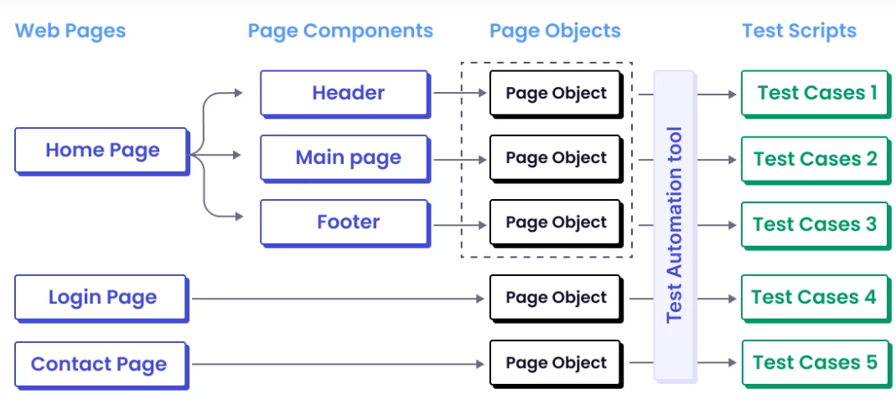
Conceptual Model
Notes:
Utilizing a design pattern like POM can help reduce code duplication and enhance maintainability issues.
Moreover, we can use POM for including reusable robust locating and waiting strategies.

Slide 10
Implementation Model
single place to change in case of UI changes
Base Page Class
Login Page class
display Page class
Cart Page class
Login Test Logic
Display Test Logic
Cart Test Logic
Notes:
Utilizing a design pattern like POM can help reduce code duplication and enhance maintainability issues.
Moreover, we can use POM for including reusable robust locating and waiting strategies.

Slide 11
Selenium POM Implementation
Notes:
Utilizing a design pattern like POM can help reduce code duplication and enhance maintainability issues.
Moreover, we can use POM for including reusable robust locating and waiting strategies.

Slide 12
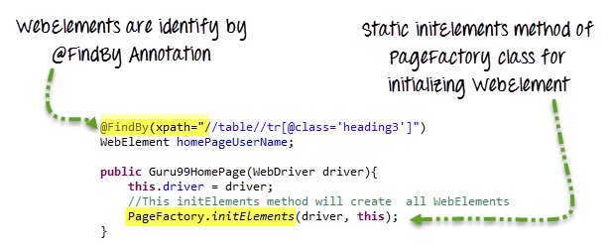
Page Factory
the name given to several support classes provided by the Selenium WebDriver API to ease the implementation of page object classes.
Notes:
Utilizing a design pattern like POM can help reduce code duplication and enhance maintainability issues.
Moreover, we can use POM for including reusable robust locating and waiting strategies.

Slide 13
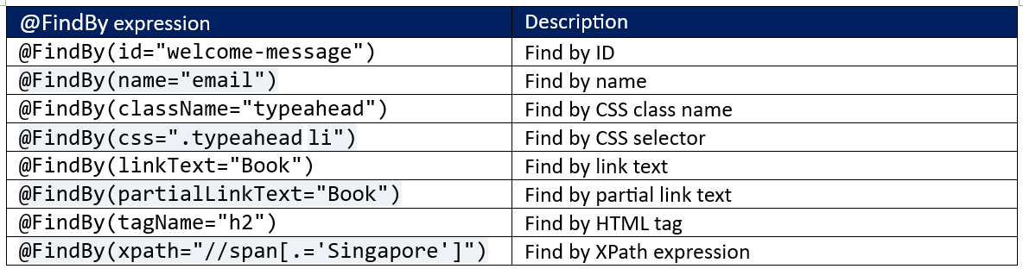
Notes:
Utilizing a design pattern like POM can help reduce code duplication and enhance maintainability issues.
Moreover, we can use POM for including reusable robust locating and waiting strategies.

Slide 14
Advantages of POM
1. Maintainability
2. Code Reusability
3. Clarity and Readability
4. Decoupling Test Logic from UI
Notes:
Utilizing a design pattern like POM can help reduce code duplication and enhance maintainability issues.
Moreover, we can use POM for including reusable robust locating and waiting strategies.

Slide 15
Disadvantages of POM
Initial Setup Time: One of the challenges with POM is the time it takes to set up initially. Creating individual page classes, defining locators, and writing methods for interacting with elements can be time-consuming, especially for large applications with many pages. This upfront investment may feel burdensome for smaller teams or projects with tight deadlines.
Increased Complexity: While POM simplifies test maintenance and readability, it can also introduce additional complexity to your test automation framework. The need to manage multiple classes and layers of abstraction can make the system harder to navigate for less experienced team members. Additionally, as more classes and methods are added, ensuring consistency across the framework requires careful organization and best practices.
Complex Page Objects: If not correctly designed, page objects can become overly complex, defeating the purpose of the model’s simplicity. Poor structure can make it harder to maintain and update the test suite as the application evolves.
Handling Dynamic Elements: It can be challenging to manage dynamic elements of an application with this approach. When elements change frequently or dynamically load, the predefined locators in the POM may become outdated quickly, requiring more frequent updates and adjustments to the page classes.
Notes:
Utilizing a design pattern like POM can help reduce code duplication and enhance maintainability issues.
Moreover, we can use POM for including reusable robust locating and waiting strategies.

Slide 16
POM Demo
Notes:
Utilizing a design pattern like POM can help reduce code duplication and enhance maintainability issues.
Moreover, we can use POM for including reusable robust locating and waiting strategies.

Slide 17
Singleton Pattern
Notes:
Utilizing a design pattern like POM can help reduce code duplication and enhance maintainability issues.
Moreover, we can use POM for including reusable robust locating and waiting strategies.

Slide 18
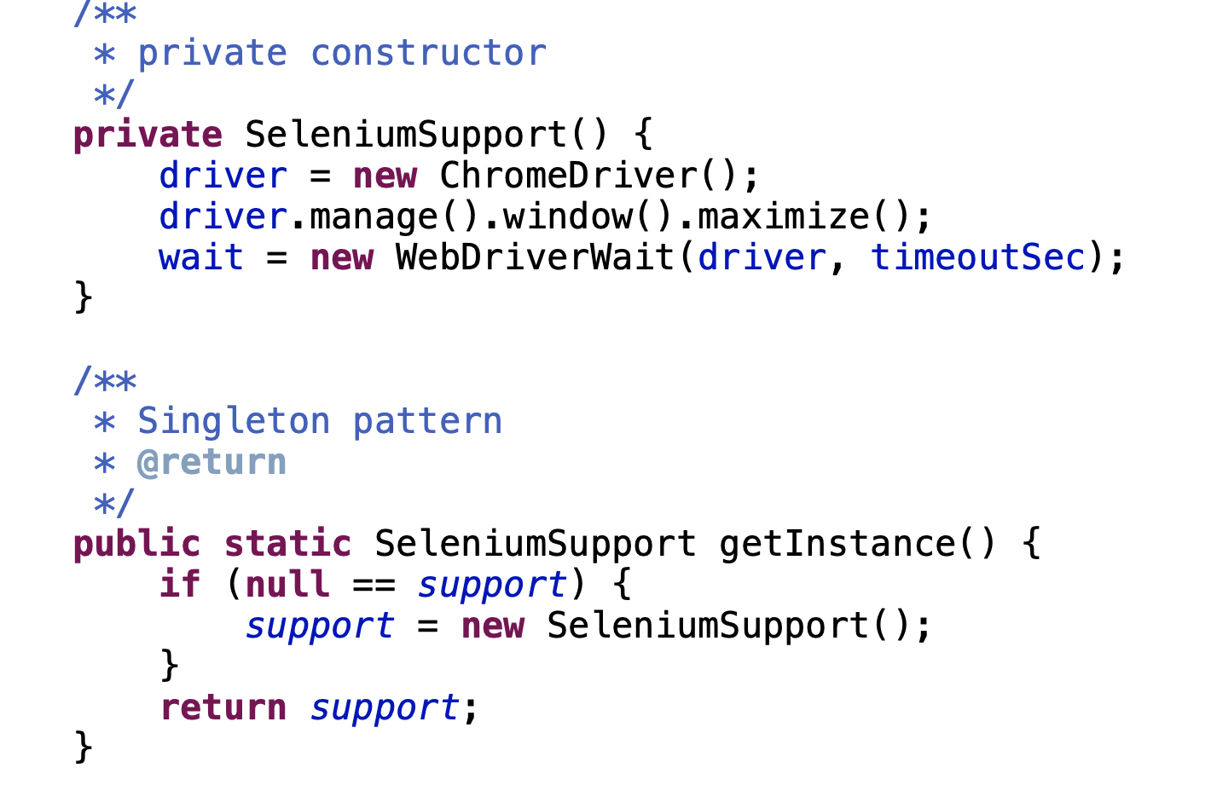
This pattern can ensure that WebDriver instances are shared across tests to prevent multiple instantiations.
Notes:
Utilizing a design pattern like POM can help reduce code duplication and enhance maintainability issues.
Moreover, we can use POM for including reusable robust locating and waiting strategies.

Slide 19
Factory Pattern
Notes:
Utilizing a design pattern like POM can help reduce code duplication and enhance maintainability issues.
Moreover, we can use POM for including reusable robust locating and waiting strategies.

Slide 20
References
https://www.browserstack.com/guide/design-patterns-in-selenium
https://www.guru99.com/page-object-model-pom-page-factory-in-selenium-ultimate-guide.html

Slide 21

Contact
WebSite: www.funnygorilla.com.au
Mail: info@funnygorilla.com.au
Linkedin: https://mt.linkedin.com/in/songqing-gu-2ba9034b/de
WebChat: Funny Training Gorilla
Phone: 0420891343

